Slide 1
NEIGHBORHOOD ROUGH SETS
Neighborhood Granulation:
An information system K = (U, A)
U is a nonempty finite set of tuples {u1, u2,…un}
A is a set of attributes {A1, A2,…Am}
A decision system is a special type of information system where A = C ∪ D
C is the set of condition attributes
D is the set of decision attributes

Slide 2
NEIGHBORHOOD ROUGH SETS CONTD…
Definition 1
A metric (sometimes called as the distance function) d is a mapping from U × U → R
For ∀x, y, z ∈U, the following three properties are satisfied:
d (x, y) ≥ 0 and d(x, y) = 0 if and only if x = y
d(x, y) = d( y, x)
d(x, z) ≤ d(x, y) + d( y, z)
Notes:
If a function satisfies these three properties it is a metric in space. Example: Real Numbers

Slide 3
NEIGHBORHOOD ROUGH SETS CONTD…
Definition 2
The δ-neighbourhood of an element x ∈ U with respect to a subset of attributes B of C is denoted by δB(x)
It is defined as δB (x) = {y∈U | dB (x, y) ≤ δ}
Here, dB is the metric associated with the set of attributes B.
Standard metrics: Manhattan, Euclidean and Chebychev – (special cases of Minkowsky)

Slide 4

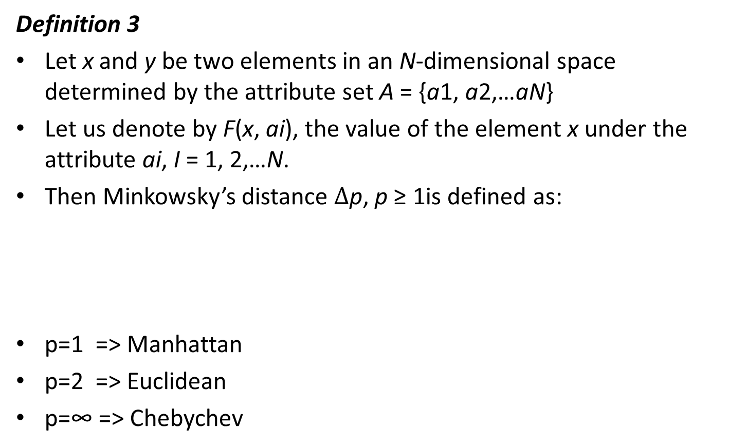
NEIGHBORHOOD ROUGH SETS CONTD…
Definition 3
Let x and y be two elements in an N-dimensional space determined by the attribute set A = {a1, a2,…aN}
Let us denote by F(x, ai), the value of the element x under the attribute ai, I = 1, 2,…N.
Then Minkowsky’s distance $∆$p, p ≥ 1is defined as:
p=1 => Manhattan
p=2 => Euclidean
p=∞ => Chebychev

Slide 5
NEIGHBORHOOD ROUGH SETS CONTD…
Definition 4
For two subsets B1 and B2 of A where B1 is a set of numerical attributes and B2 is a set of categorical attributes, the neighbourhood granules of an element x in U with respect to B1, B2 and B1 ∪ B2 are denoted by respectively

Slide 6
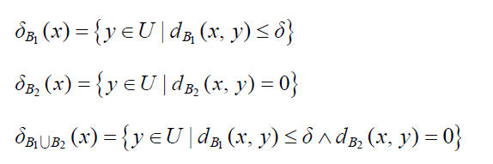
NEIGHBORHOOD ROUGH SETS CONTD…
Definition 4 ctd…
and are defined as

Slide 7
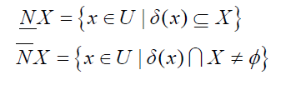
NEIGHBORHOOD ROUGH SETS CONTD…
Definition 5
Given a set of objects U and a neighbourhood relation N over U, we say that (U, N) is a neighbourhood approximation space.
With respect to this relation, we define the lower and upper approximation of a subset X of U as

Slide 8

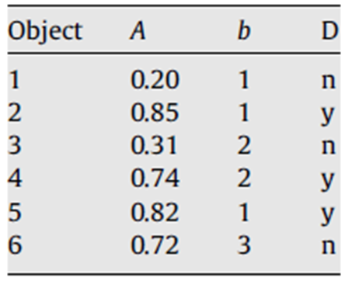




Example – Neighborhood Granulation (w.r.t attribute ‘A’ and a neighborhood threshold) of 0.01

Slide 9

NEIGHBORHOOD ROUGH SETS CONTD…
Definition 6
Mean neighbourhood roughness is the mean of neighbourhood roughness of each unique value set (of attributes).
Neighbourhood roughness of each attribute with respect to every other attribute is tabulated.
If v1, v2, v3,…,vn are the values in the domain of an attribute f, then we calculate a neighbourhood-based lower and upper approximation of that attribute for each of the values – v1, v2, v3,…,vn with respect to every other attribute and take a mean of those values.

Slide 10
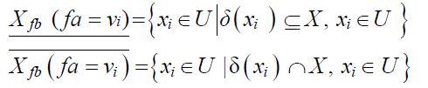
NEIGHBORHOOD ROUGH SETS CONTD…
Definition 6 ctd…
Similarly, neighbourhood roughness between fa and fb are calculated for each of the domain values in the value set V (fa) of fa and their mean is calculated
This neighbourhood roughness has to be calculated between every pair of attributes
Definition 5 is upheld in the following form. Our MMNR algorithm applies this to calculate neighborhood-based roughness between two attributes either categorical or numerical.

Slide 11


NEIGHBORHOOD ROUGH SETS CONTD…
Definition 7 ctd…
Neighbourhood of each xi in U is defined as the union of the neighbourhoods xi of fa and fb
Mean neighbourhood roughness:

Slide 12
SAMPLE DATA SET
 | A1 | A2 | A3 | A4 | A5 | A6 | A7
x1 | good | dark | opaque | 0.2 | region1 | torrid | qualityIndex2
x2 | average | grey | translucent | 0.85 | region3 | tropical | qualityIndex3
x3 | fair | lightgrey | transparent | 0.31 | region2 | temperate | qualityIndex1
x4 | average | dark | translucent | 0.74 | region2 | torrid | qualityIndex2
x5 | fair | lightgrey | transparent | 0.82 | region1 | torrid | qualityIndex3
x6 | good | verydark | opaque | 0.72 | smooth | tropical | qualityIndex1
x7 | fair | lightgrey | opaque | 0.9 | region1 | arctic | qualityIndex1
x8 | fair | lightgrey | transparent | 0.64 | region1 | torrid | qualityIndex1
x9 | good | verydark | opaque | 0.56 | region3 | tropical | qualityIndex3
x10 | average | verydark | translucent | 0.4 | region3 | torrid | qualityIndex3

Slide 13



NEIGHBORHOODS
$$δ\left(A1\right)$$
$$δ\left(A2\right)$$
$$δ\left(A1\right)∪ δ(A2)$$
x1 | {x1, x6, x9} | {x1, x4} | {x1,x4,x6,x9}
x2 | {x2,x4,x10} | {x2} | {x2,x4,x10}
x3 | {x3,x5,x7,x8} | {x3,x5,x7,x8} | {x3,x5,x7,x8}
x4 | {x2,x4,x10} | {x1, x4} | {x1,x4,x2,x10}
x5 | {x3,x5,x7,x8} | {x3,x5,x7,x8} | {x3,x5,x7,x8}
x6 | {x1, x6, x9} | {x6,x9,x10} | {x1,x6,x9,x10}
x7 | {x3,x5,x7,x8} | {x3,x5,x7,x8} | {x3,x5,x7,x8}
x8 | {x3,x5,x7,x8} | {x3,x5,x7,x8} | {x3,x5,x7,x8}
x9 | {x1, x6, x9} | {x6,x9,x10} | {x1,x6,x9,x10}
x10 | {x2,x4,x10} | {x6,x9,x10} | {x2,x4,x6,x9,x10}

Slide 14
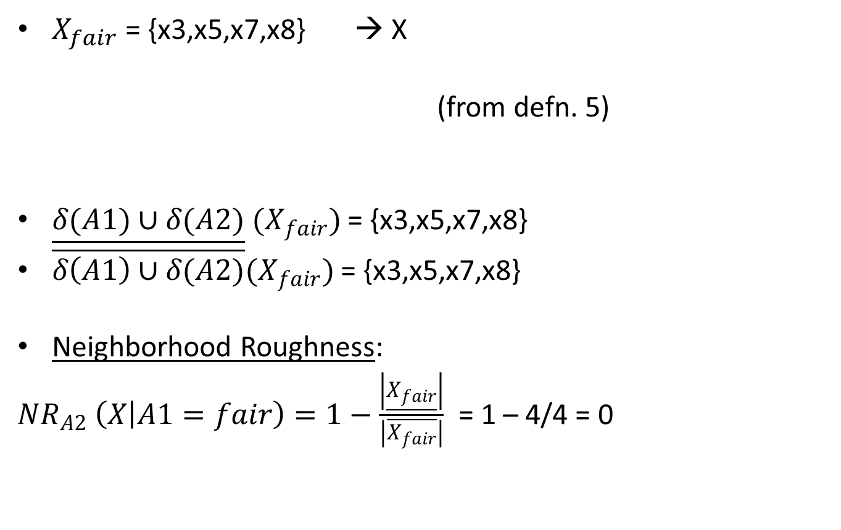
Procedure:
$X_{fair}$ = {x3,x5,x7,x8} → X
(from defn. 5)
$\underline{δ(A1)∪δ(A2)} (X_{fair})$ = {x3,x5,x7,x8}
$\overline{δ\left(A1\right)∪δ(A2)}(X_{fair})$ = {x3,x5,x7,x8}
Neighborhood Roughness:
${NR}_{A2}$ $\left(X | A1=fair\right)=1−\frac{\left|\underline{X_{fair}}\right|}{\left|\overline{X_{fair}}\right|}$ = 1 – 4/4 = 0

Slide 15
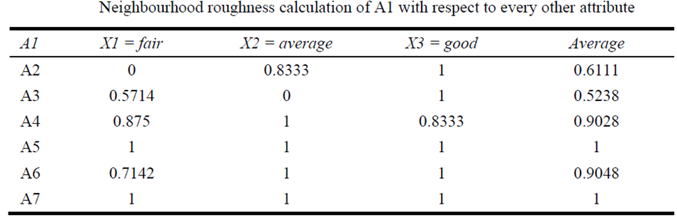
NEIGHORHOOD ROUGHNESS CALCULATION OF A1 WITH RESPECT TO EVERY OTHER ATTRIBUTE

Slide 16
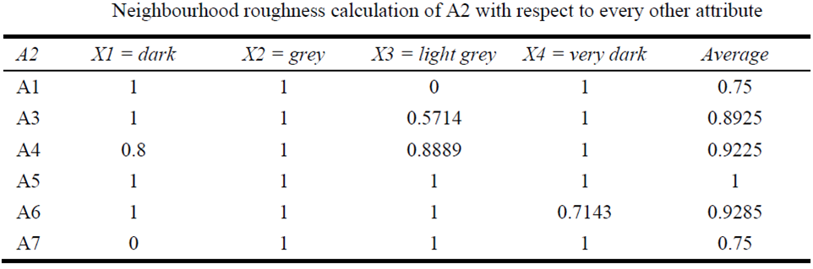
NEIGHORHOOD ROUGHNESS CALCULATION OF A2 WITH RESPECT TO EVERY OTHER ATTRIBUTE

Slide 17
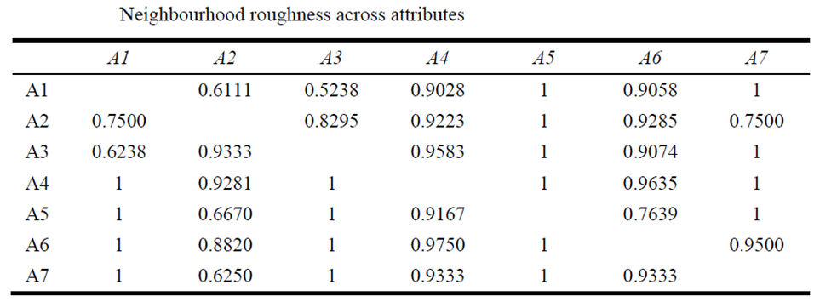
NEIGHBORHOOD ACROSS ATTRIBUTES

Slide 18
SPLITTING ATTRIBUTE
Attribute A1 is chosen as the Splitting Attribute as it has the minimum roughness of 0.5238
Referring to the earlier table, the subset X= fair in A1 has the minimum roughness and the splitting is on X(a1=fair) Vs X(a1=good), X(a1=average)
A1
good, average
fair
(1,2,4,6,9,10)
(3, 5, 7,8)

Slide 19
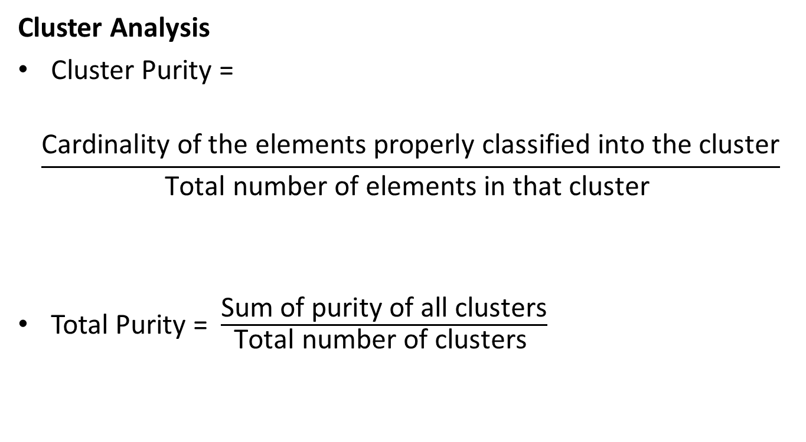
ACCURACY MEASURE
Cluster Analysis
Cluster Purity =
$$\frac{\text{Cardinality} \text{of} \text{the} \text{elements} \text{properly} \text{classified} \text{into} \text{the} \text{cluster}}{\text{Total} \text{number} \text{of} \text{elements} \text{in} \text{that} \text{cluster} }$$
Total Purity = $\frac{\text{Sum} \text{of} \text{purity} \text{of} \text{all} \text{clusters}}{\text{Total} \text{number} \text{of} \text{clust}\text{er}\text{s} }$

Slide 20
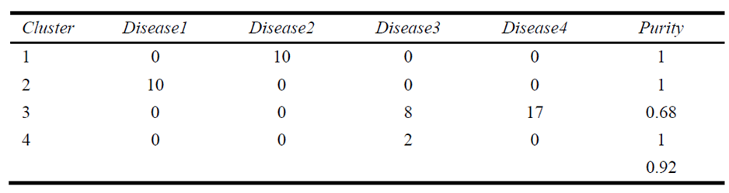
MMNR Algorithm on Soybean Data Set (UCI)
Soybean data set has 47 objects on diseases in soybeans – stem canker, charcoal rot, root rot, and phytophthora rot
35 categorical attributes
Of these Phytophthora had 17 objects and the others had 10 objects each
Notes:
UCI repository

